Slide 1
Dropping Functions
Removing user-defined functions from the database when they are no longer needed.

Slide 2
Introdution
The SQL Server DROP FUNCTION statement is used to remove user-defined functions from the database. It is a simple command that allows you to easily delete functions that are no longer necessary for your database. This statement is particularly useful when you need to make changes to a function or when you want to remove a function altogether.

Slide 3
Mangement
Select the plus sign next to the database that contains the function you wish to modify.
Select the plus sign next to the Programmability folder.
Select the plus sign next to the folder that contains the function you wish to modify:
Table-valued Function
Scalar-valued Function
Aggregate Function
Right-click the function you want to delete and select Delete.
In the Delete Object dialog box, select OK.
Select Show Dependencies in the Delete Object dialog box to open the function_name Dependencies dialog box. This will show all of the objects that depend on the function and all of the objects on which the function depends

Slide 4
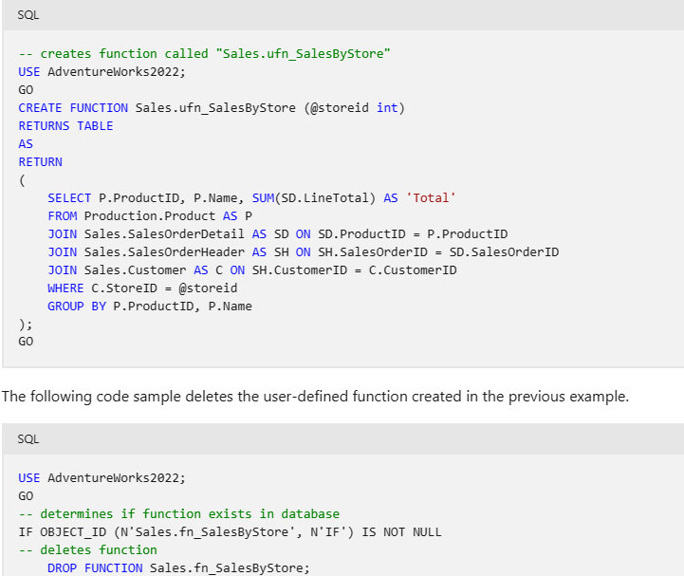
Query

Slide 5
Limitations and restrictions
You won't be able to delete the function if there are Transact-SQL functions or views in the database that reference this function and were created by using SCHEMABINDING, or if there are computed columns, CHECK constraints, or DEFAULT constraints that reference the function.
You won't be able to delete the function if there are computed columns that reference this function and have been indexed

